Slide 1

FACE RECOGNITION ATTENDANCE SYSTEM
ABDULFETTAH SANCAKLI B1705.010027

Slide 2
CONTENT
IMPLEMENTATIONS
CODE EXPLAINATIONS
WHAT IS FACE RECOGNITION
PROBLEM STATEMENT
WHAT PROBLEM DOES FACE RECOGNITION SOLVE
AIMS AND OBJECTIVES
SYSTEM OVERVIEW
SYSTEM ARCHITECTURE
FACE DETECTION
FACE RECOGNITION

Slide 3
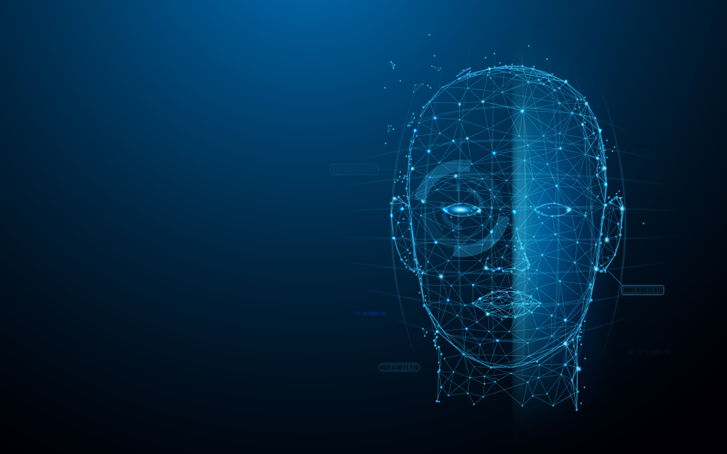
INTRODUCTION
BIOMETRIC
STUDENT DETAILS
FACE DETECTION
TRAINING IMAGES
FACE RECOGNITION
ATTENDANCE FILE

Slide 4
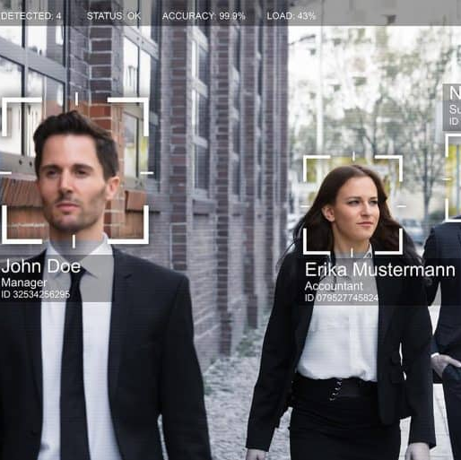
WHAT IS FACE RECOGNITION
Facial recognition is a way of recognizing a human face through technology. A facial recognition system uses biometrics to map facial features from a photograph or video. It compares the information with a database of known faces to find a match. Facial recognition can help verify a person’s identity

Slide 5
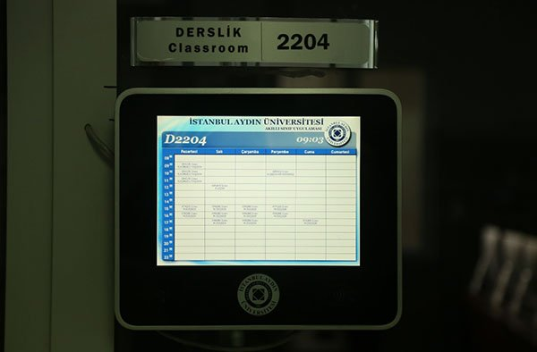
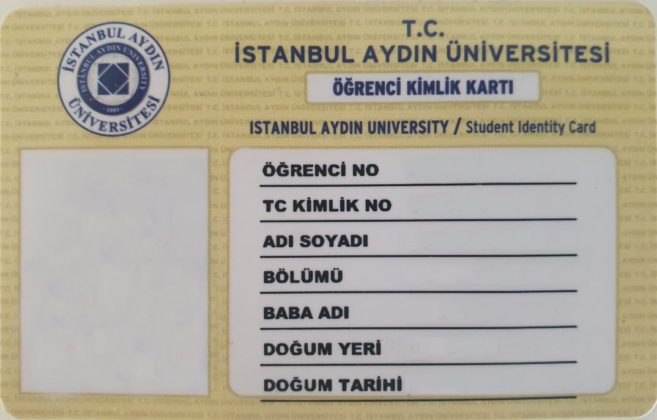
PROBLEM STATEMENT
RFID
Forgotten or Corrupted Card
Time
Fake Attendance

Slide 6




WHAT PROBLEM DOES FACE RECOGNITION SYSTEM SOLVE
1-Automated
2- Economically
3-Effective
4- Keep extra time

Slide 7
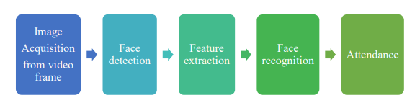




AIMS AND OBJECTIVES
Detect
Extract
To detect the face segment from the video frame.
To extract the useful features from the face detected.
Classify
Record
To classify the features in order to recognize the face detected.
To record the attendance of the identified student.

Slide 8
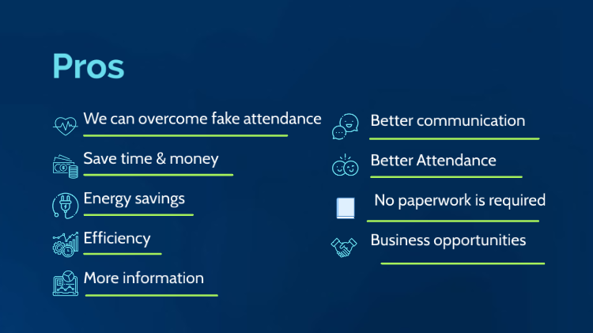
ADVANTAGES OF FACE RECOGNITION

Slide 9

DISADVANTAGES OF FACE RECOGNITION

Slide 10
SYSTEM OVERVIEW

Slide 11
SYSTEM ARCHITECTURE

Slide 12








SYSTEM REQUIREMENTS
Software Requirements
Hardware Requirements
WEB Camera.
GPU for faster video processing.
Secondary memory to store images
Libraries
IDE
Python PyCharm

Slide 13
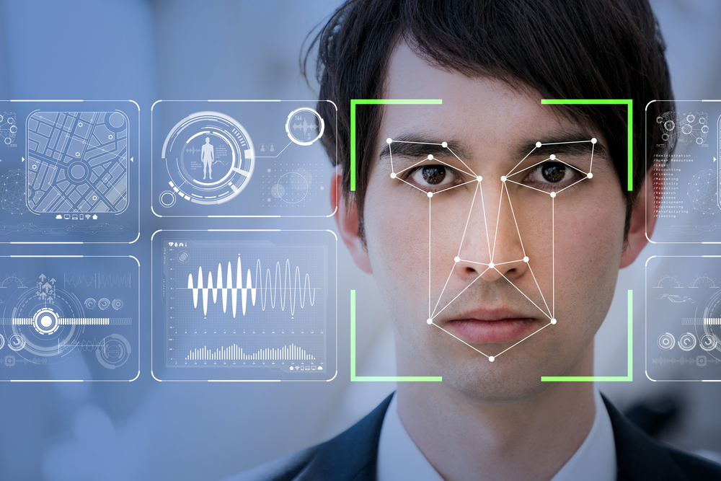
WHAT IS FACE DETECTION
It has the objective of finding the faces (location and size) in an image and probably extract them to be used by the face recognition algorithm.

Slide 14
HOW FACE DETECTION WOKRS
Step 1:, We will require an image, to begin with..
Step 2: Read the image and the features file.
Face rectangle coordinates.
Step 3: Displaying the image with the rectangular face box.

Slide 15
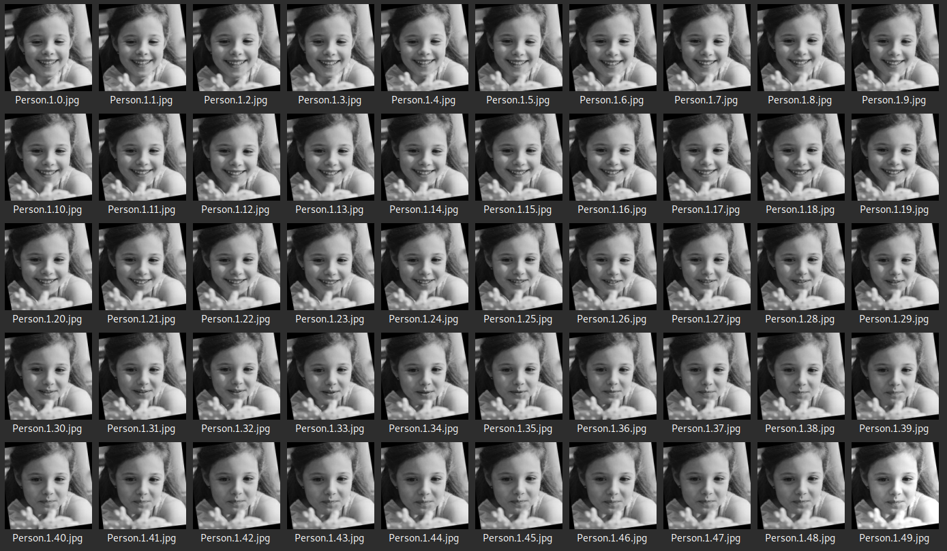
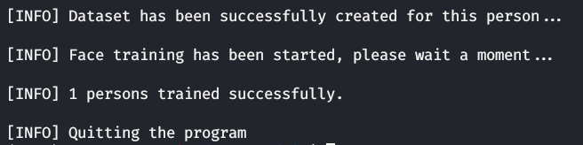
DATA COLLECTION-TRAIN
The face images that users enter into the system should be trained by artificial intelligence by taking examples of 100 different positions from each student.
A dataset is obtained with photos taken from each student.

Slide 16
HOW FACE RECOGNITION WORKS
CAPTURE
EXTRACTION
COMPARISON
MATCHING

Slide 17
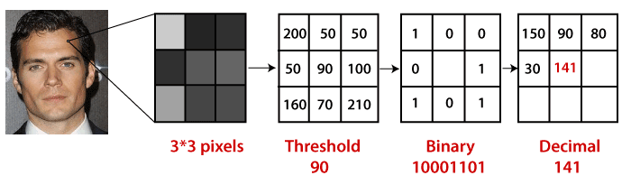
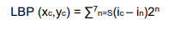
FACE RECOGNITION ALGORITHM
Local Binary Pattern (LBP) is a simple yet very efficient texture operator which labels the pixels of an image by thresholding the neighborhood of each pixel and considers the result as a binary number
1. Selecting the Parameters: The LBPH accepts the 4 parameters : Radius, Neighbors, Grid X, Grid Y
2. Training the Algorithm
3. Using the LBP operation

Slide 18
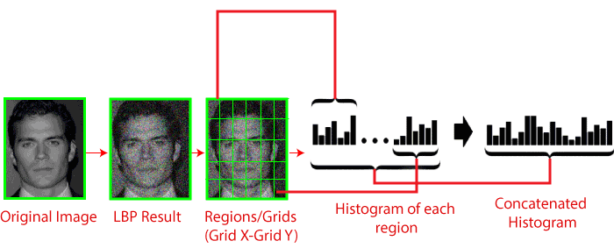
FACE RECOGNITION ALGORITHM
4. Extracting the Histograms from the image

Slide 19
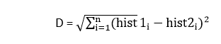
FACE RECOGNITION ALGORITHM
5.Performing face recognition
Use Euclidean distance based on the following formula:

Slide 20
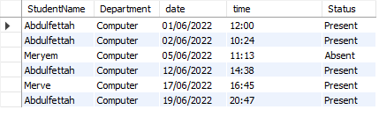
ATTENDANCE FILE
The system pre-class students who register during the introduction, we use the face detection and recognition algorithms with their faces after the camera reads the student who is information that is found in the database by matching the student's class participation and in an Excel file that shows the student's name , the date and time shown in the chart is an absence of the face was detected.

Slide 21
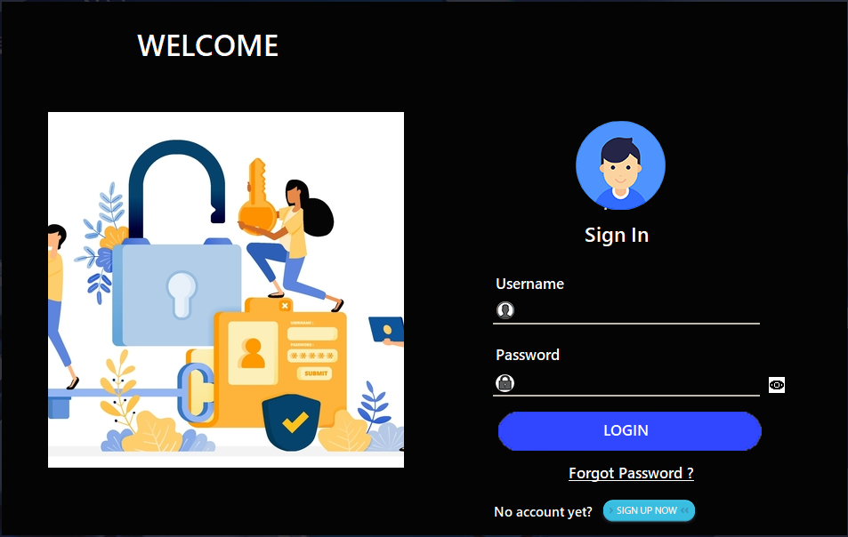
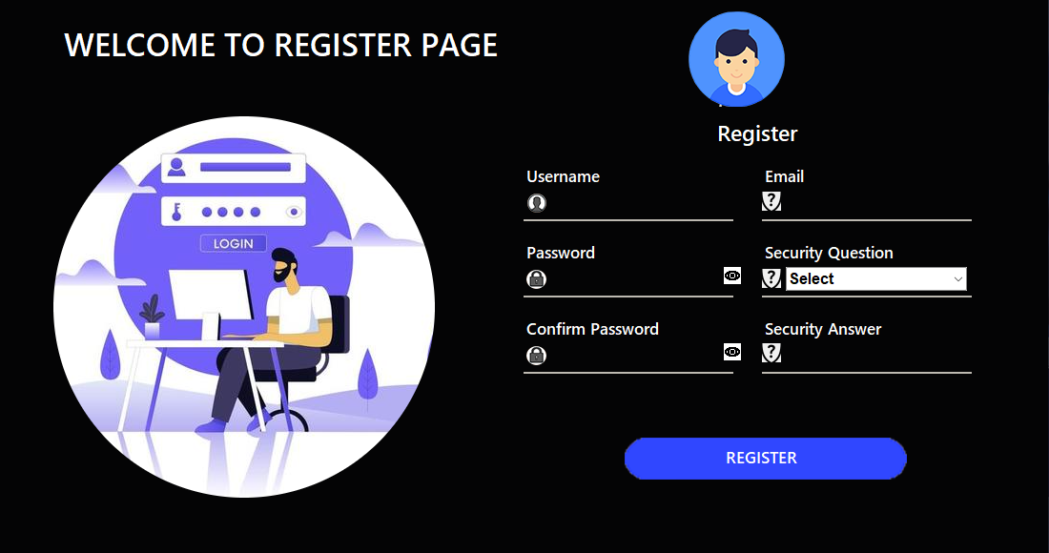
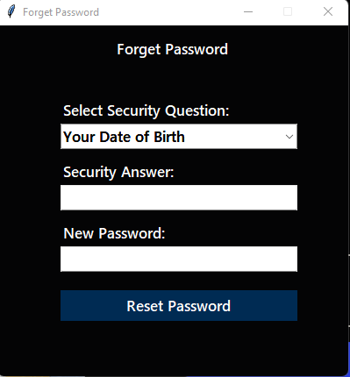
IMPLEMENTATIONS

Slide 22
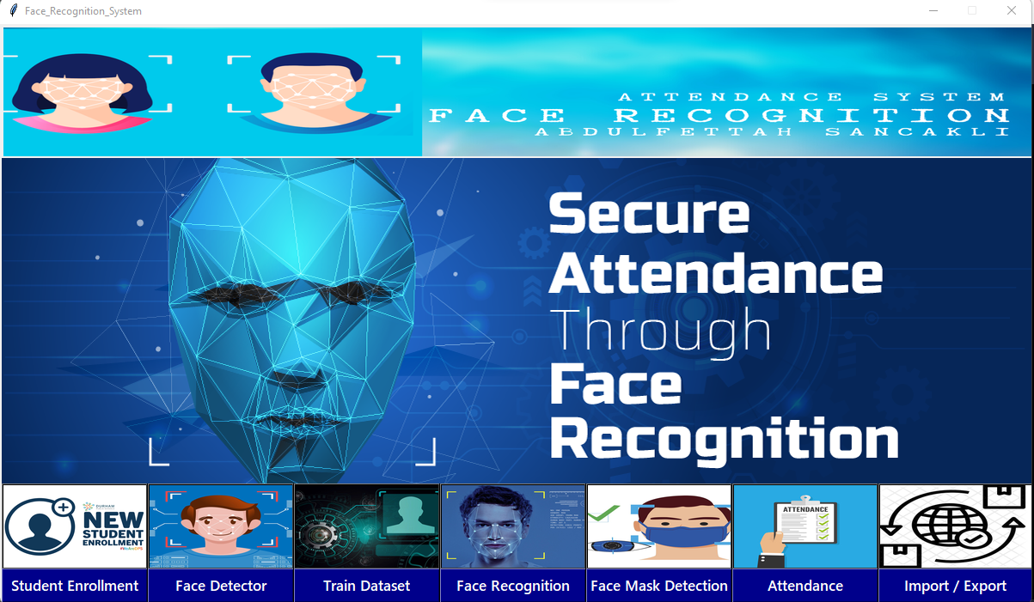

Slide 23
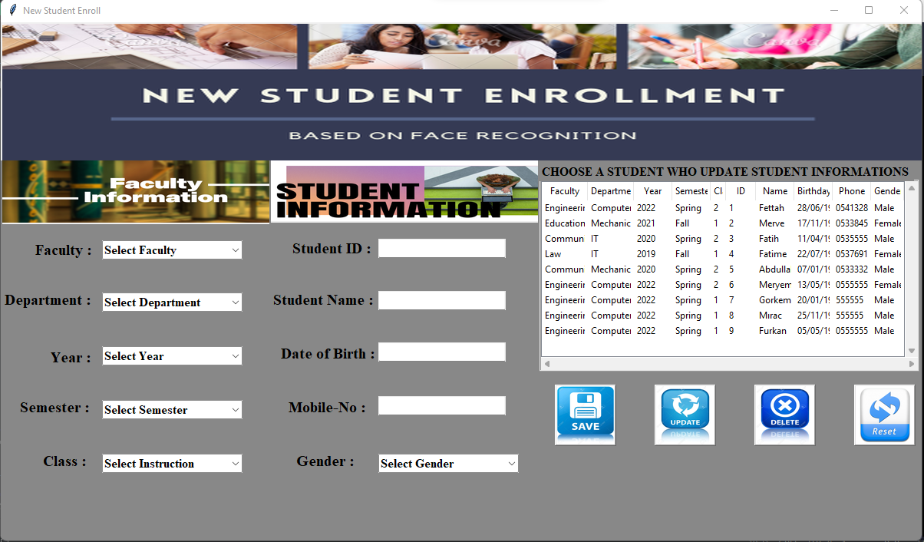

Slide 24
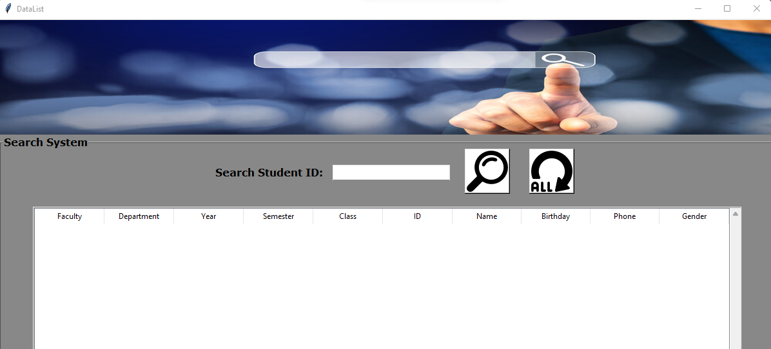

Slide 25
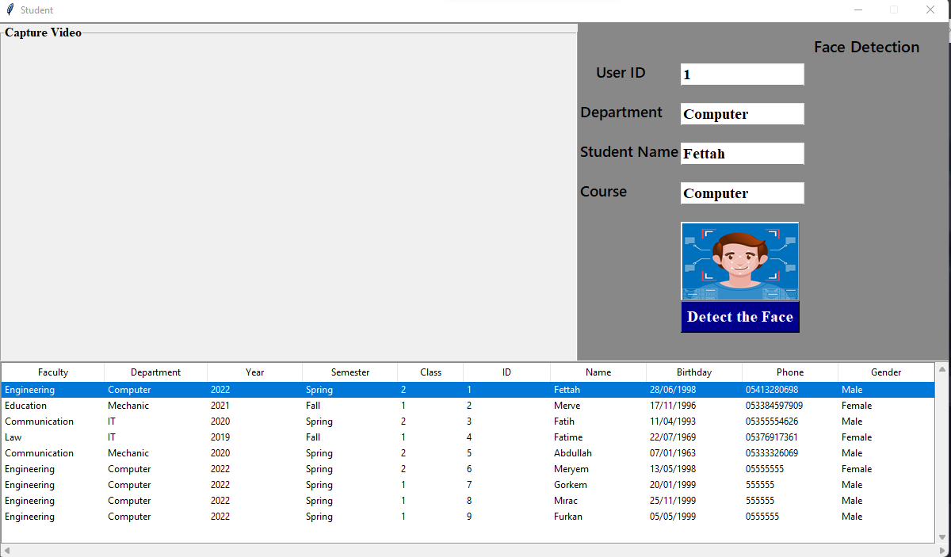

Slide 26


Slide 27
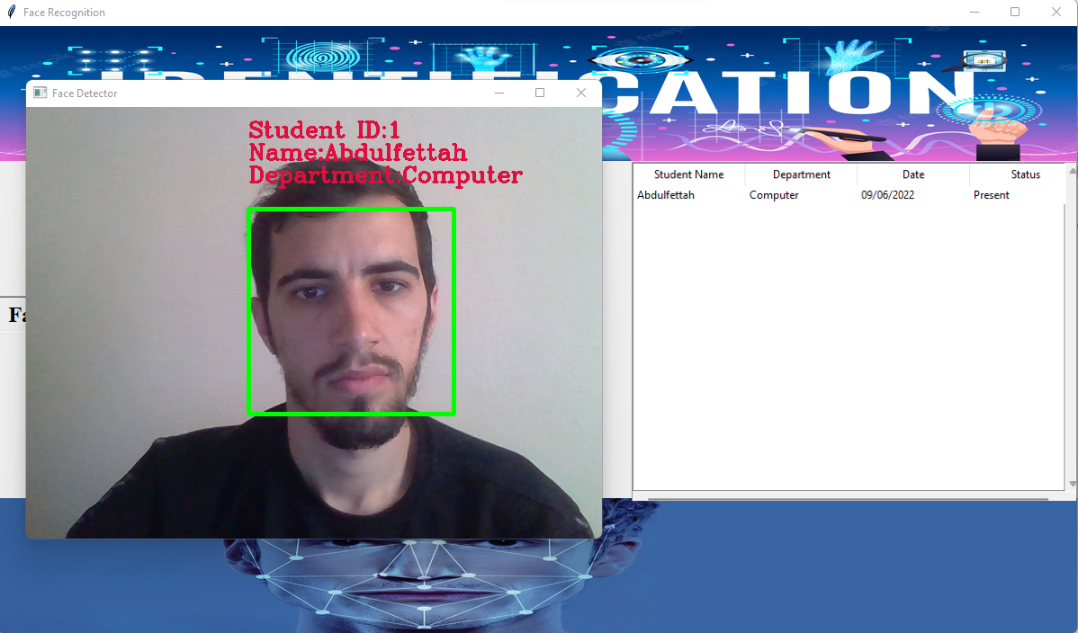

Slide 28
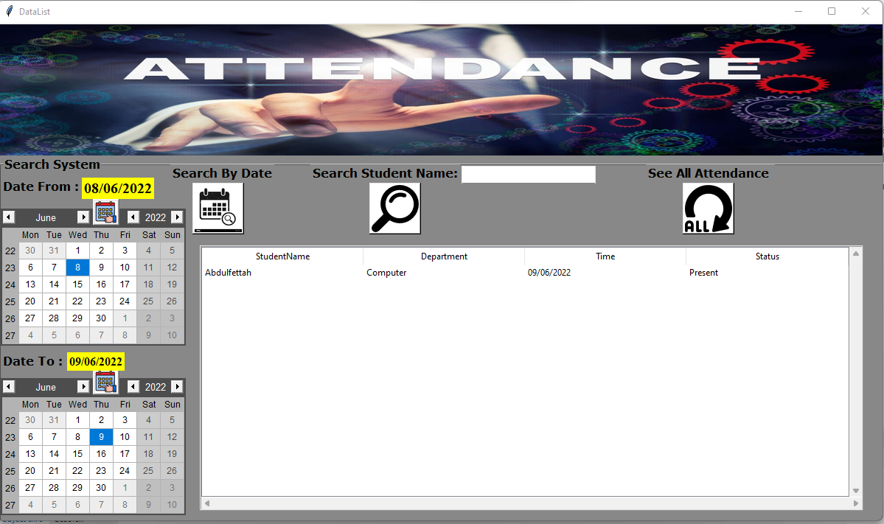

Slide 29
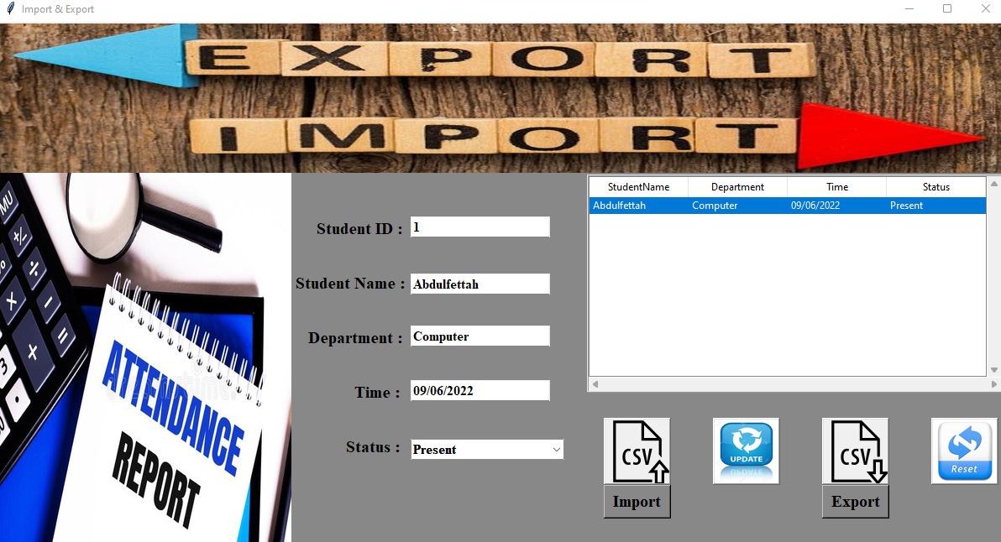

Slide 30
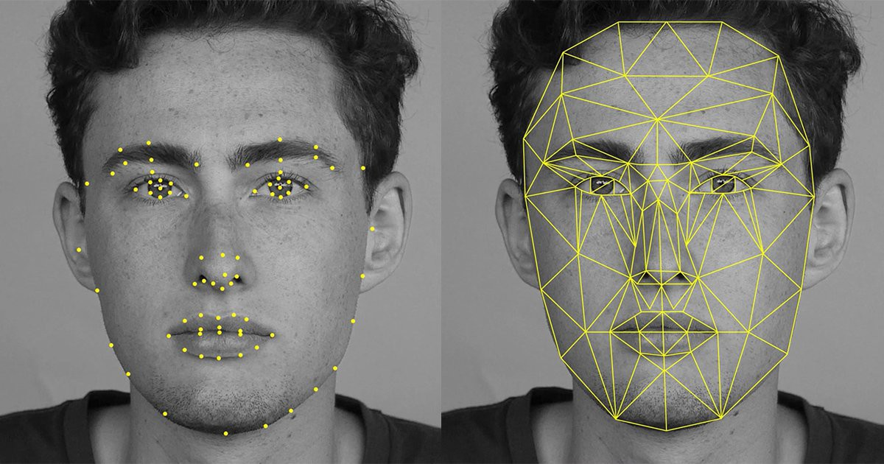
CONCLUSION
The purpose of reducing the errors that ocur in the traditional attendance taking system has been achieved by implementing this automated attendance system.By using this technology we can overcome the problems of fake attendance. We can save time and efficiency is more. Summing it up, every new facial recognition represents huge perspectives and promises fort the future evolution.

Slide 31

FUTURE WORK
It is planned that facial recognition algorithms will be systemically encoded as a program later in our project. In order to minimize the problems of face recognition systems, it is considered to be a high resolution camera and a bright environment set. Deficits in the system with a fake picture hanging system which is one of the largest planned to continue research about the problem.

Slide 32

THANK YOU FOR LISTENING TO ME

